Slide 1
Blockchain Disruption and Smart Contracts
Author: Lin William Cong Zhiguo He
Presented by Lewis Luo
September 19, 2018
Topics in Quantitative Finance

Slide 2
Outline
Introduction & Institutional Background
Decentralized Consensus & Information Distribution
A simple model (Trade & Finance)
A formal mathematical model
Applications
Regulation & Discussion
Conclusion & Thoughts

Slide 3
What is Blockchain?
Bitcoin – the original blockchain: double-spending, distributed ledger.
A database system in which parties unknown to each other can jointly maintain and edit in a decentralized manner, with no individual party exercising central control.
Notes:
Blockchain, a distributed ledger technology managed in a decentralized manner, was first popularized as the technology behind the cryptocurrency Bitcoin. It has since emerged in various other forms, often with the ability to store and execute computer programs.

Slide 4
What is Smart Contract?
An application of Blockchain
Smart contracts are digital contracts allowing terms contingent on decentralized consensus and are self-enforcing and tamper-proof through automated execution.
Notes:
Smart contracts can help facilitate exchanging money, property, shares, service, or anything of value in an algorithmically automated and conflict-free way
What smart contract is NOT?, centralized authority, human-intermediation/execution, “smart”/AI, complete contract.
Applications in the Financial Industry: Trusted payments Trade finance Trading and exchanges

Slide 5
Blockchain Features
Decentralized consensus
Safe, robust, cheap, & decentralized.
Errors, manipulations, & attacks.
Information Distribution
Record-keepers, incentives, organization & community.
Privacy, transparency, encryption, & informational environment.
Notes:
Decentralized consensus is a description of the state of the world—e.g., whether the goods have been delivered or whether a payment has been made—that is universally accepted and acted upon by all agents in the system.
Without decentralized consensus, the party providing centralized consensus often enjoys huge market power (for example, a third party with data monopoly).

Slide 6
Decentralized Consensus
PoW (Proof-of-work)
record keepers who solve complicated cryptographical puzzles in order to validate transactions and create new blocks (i.e., mining)
PoS (Proof-of-stake)
chosen in a deterministic manner, depends on his/her wealth (i.e., the stake)

Slide 7
Information Distribution
Decentralized consensus requires information distribution among participants in the system.
Business Privacy
Notes:
Achieving decentralized consensus requires information distribution among participants in the system.

Slide 8
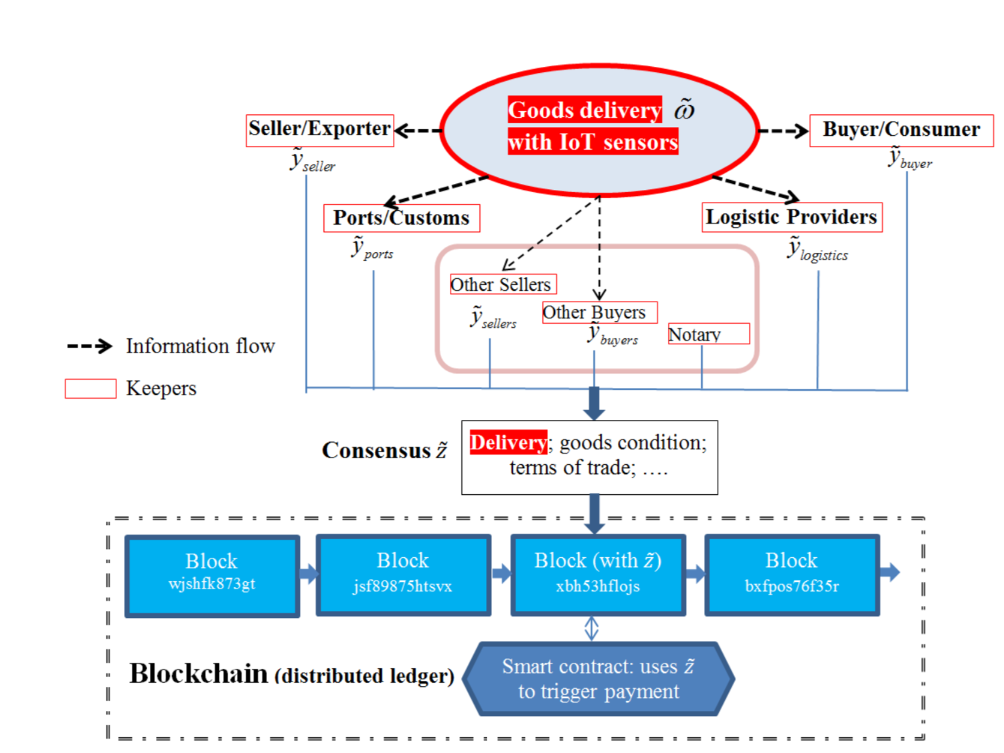
Trade-Finance Example

Slide 9
Formal Model Setup
ω ̃: :delivery of service of goods
z˜: decentralized consensus
y_{k}˜: reports; y ≡ {y_{k}˜ }: collection of reports
K ≡ {1, 2, · · · , K} homogeneous
Effectiveness: −Var(ω˜−z˜)
w_{k}: weight non-negative sum to 1
Notes:
The random variable ω ̃ takes the value of one if the delivery is successful and zero otherwise
Denote the decentralized consensus on ω on a blockchain by z which takes value in {0, 1} as well
Upon contact, each record keeper k ∈ K submits y􏰐 taking values in {0,1}, yielding a collection of reports y ≡ {y } .
In reality, the effectiveness depends on the purpose and use of consensus on each specific blockchain
For illustration, we examine the case where the consensus is given by this formulation
We also assume that wk → 0 as K → ∞, which captures the key concept of decentralization.
Our results hold for a general z(y), and satisfies that E[Z ̃] is differentiable and increasing in the argument, and takes the value of 0 or 1 when the argument is 0 or 1. This implies that if the reports are all accurate, the consensus reflects the true state of the world.

Slide 10
Formal Mathematical Model
Reduced-form model:
b_{k}: record keeper k’s benefit
hk: cost of misreporting, reputation cost
Information Distribution vs. Quality of Consensus:
Notes:
we assume that each risk-neutral record keeper k submits a report of yk to maximize his normalized utility function
The first coefficient bk is record keeper k’s benefit when the wrong consensus is reached; In the second term, hk captures the cost of misreporting.
Each contacted record keeper chooses yk to optimize U, which gives the (1) equation here
The benefit of misreporting is bkwk because it shifts the consensus by wk given other people’s equilibrium strategies, whereas the cost is hk (2)
The equilibrium consensus then is (3)

Slide 11
Formal Mathematical Model
Quality of Decentralized Consensus:
Conclusion
Information Distribution vs. Decentralized Consensus
Notes:
Notice that V ar(2ω ̃ − 1) is independent of K. Therefore, the greater the set K∗, the higher the quality of the decentralized consensus. The greater the degree of information distribution, the higher the quality of decentralized consensus.

Slide 12
Blockchain Applications in the Financial Industry
Trade Finance
Fail because of not well-known letter of credit
Fail because of worries of timely delivery of goods
Solutions
Flow of Money
Decentralized ledger better track goods
Flow of Goods
Trusted Payments

Slide 13
Blockchain Applications in the Financial Industry
Trusted Payments
Bitcoin: a blockchain that is secure and time-stamped to make it tamper-proof;(Nakamoto (2008))
Ethereum: the second largest blockchain platform by market capitalization after the Bitcoin blockchain
Ripple: founded in 2012 to provide global financial transactions and real-time cross-border payments

Slide 14
Blockchain Applications in the Financial Industry
Exchanges and Trading
Voting
Syndicated loans

Slide 15
Regulatory Measures
Blockchain competition
Regulatory node and design
Separation of keepers of users
Blockchain and smart contract design
Notes:
In practice there are likely to be multiple blockchains which both sellers and buyers can choose, as buyers can always pick the blockchain which offers the best price-adjusted service.
Adding a regulatory node in the blockchain can help regulator monitor the economic behaviors of market participants and reduce tacit collusion.

Slide 16
Conclusion & Thoughts
Blockchain and Smart Contract
Decentralized consensus, low-cost, tamper-proof algorithmic execution
Consensus generation: information distribution vs privacy
Tradeoffs of consensus generation vs. information distribution
Future Topics
A robust consensus protocol
Right incentives for consensus
Notes:
In this paper we argue that decentralized ledger technologies such as blockchains feature decentralized consensus as well as tamper-proof algorithmic executions, and consequently enlarge the contracting space and facilitate the creation of smart contracts.
However, the process of reaching decentralized consensus changes the information environment on the blockchain, potentially engendering welfare-destroying consequences by promoting collusion

Slide 17
Thanks for listening!

